Slide 1
IT Admin 304:
Advanced Topics in Identity Management
Brianna Blanchard, Laserfiche

Slide 2
Agenda
SSO
  Overview of setup
  External access options
SAML
  Introduction
  Configuration
  User management
MFA/2-FA
(Single Sign On)
(Security Assertion Markup Language)
(Multi-factor authentication)

Slide 3
Fundamentals
SSO Configuration
Notes:
If this part feels really quick, that’s because it is. A lot of this information has been covered in years past and is in the documentation
For tips on SSO configuration, check out the class “Troubleshooting Access and Authentication”

Slide 4
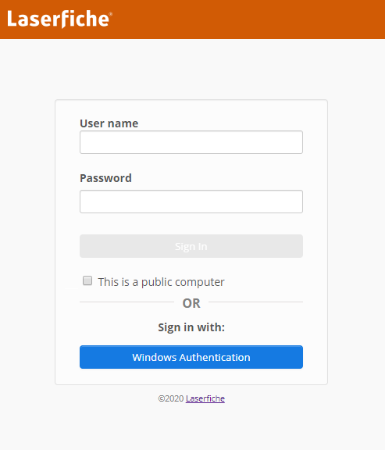
SSO Quick Overview
Available for web applications and Laserfiche App
LFDS STS/WebSTS = web application that hosts SSO
Basic login options:
  Laserfiche User
  LDAP authentication
  Windows Authentication

Slide 5
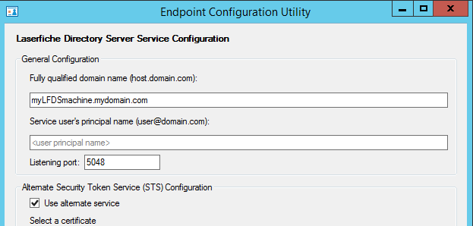

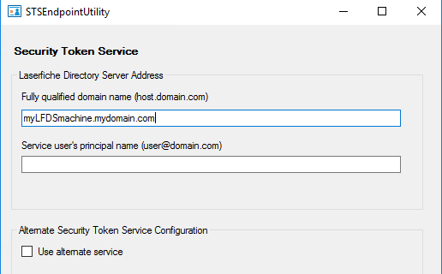
Basic Configuration
STS and LFDS endpoints
Fully qualified domain name
  LFDS machine, not STS or web application machine
Service user principal name
  Blank = Network Service
  LocalSystem
  user@domain.com
Match values
LFDS 10.4.1

Slide 6
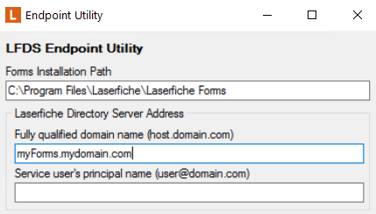
Web Application Configuration
Endpoint utilities
Always match LFDS utility
  LFDS machine name
  Service user name in LFDS
Configuration pages
LFDS site display name
LFDS STS URL --- may be same machine as LFDS
Notes:
Always match = put the same value in
The LFDS intro lab shows SSO configuration

Slide 7
New to 10.4.3: HTTPS configuration
10.4.2 and prior:
  Based on WCF (Windows Communication Foundation)
  Message-layer security
Now:
  STS and LFDS communicate over raw HTTP
  Transport-layer security (TLS)
  Communication with web applications still WCF (for now)
Notes:
10.4.3 for LFDS is 10.4.2 release
Raw HTTP is more flexible, so it makes some new features possible.

Slide 8
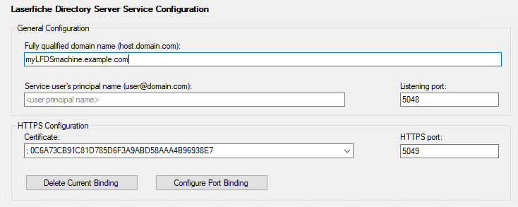
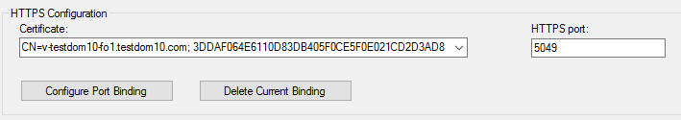
New to 10.4.3: HTTPS configuration
Bind certificate to port on LFDS machine
Can be done through LFDS endpoint utility
Select valid certificate
Bind to HTTPS port
Notes:
10.4.3 for LFDS is 10.4.2 release

Slide 9
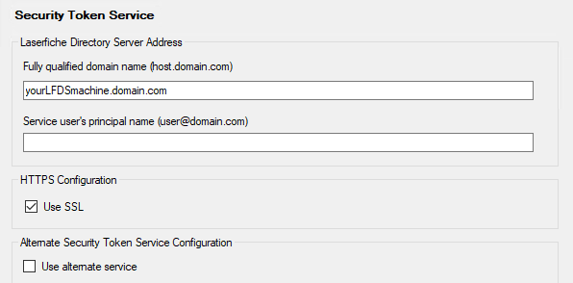
New to 10.4.3: HTTPS configuration
Bind certificate to port on LFDS machine
Can be done through LFDS endpoint utility
Enable in STS endpoint utility
Turn on SSL
Notes:
10.4.3 for LFDS is 10.4.2 release

Slide 10
HTTPS Configuration: FAQ
Certificate requirements?
  Valid on all involved machines (more in a minute)
Backwards compatible?
  Yes: LFDS works with older web applications
…the old version wasn’t https?!
  Encrypted at message level

Slide 11
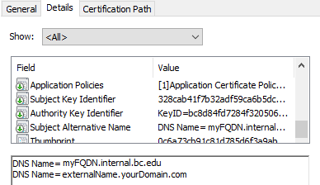
Certificate Requirements
Both LFDS and STS machine must see cert as valid
Certificate authority trusted on LFDs and STS machine
Include true FQDN of machine and external name
Notes:
Subject Alternative Name is how you can make sure to include all necessary machine names. Note that SANs cannot be modified on existing certificates; you must issue a new certificate

Slide 12
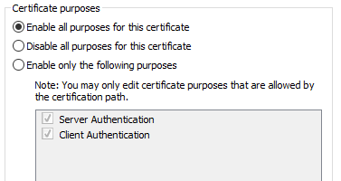
Certificate Requirements
LFDS needs appropriate rights
Private key on LFDS machine
Enable both Server and Client Authentication
Notes:
Usually the default settings, but good to check

Slide 13
External Access
Alternate SSO Configuration
Notes:
What about users outside the company network? There are a few pieces to consider, but first I’ll look at how this affects the SSO configuration

Slide 14





External Access Overview
Additional STS installation
Enable alternate connection mode for LFDS
Configure STS and end applications
Web Client Server
Forms Server
Internal Laptop
External Laptop
Certificate
Mode Enabled
SSO page
LFDS
+
SSO page
Internal Network
DMZ

Slide 15
Setup Checklist for SSO Access in DMZ
Configure LFDS to accept “alternate service”
Install WebSTS and web applications in DMZ
Configure endpoint utilities with certificates for:
  Additional WebSTS machine
  Any web servers in the DMZ (e.g., Forms, Mobile)
Point DMZ web applications to DMZ WebSTS

Slide 16
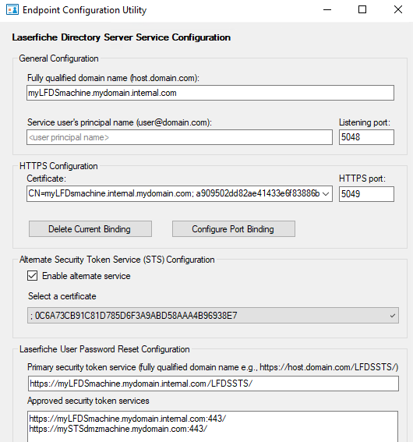
Configuring LFDS
Turn on Alternate Service
Select valid certificate
May be different
Notes:
The alternate service certificate may be different from the HTTPS certificate

Slide 17
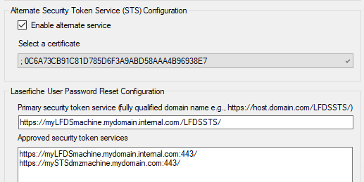
Configuring LFDS
Turn on Alternate Service
Select valid certificate
Notes:
Let’s zoom in

Slide 18
Configuring LFDS
1. Where will users normally change passwords?
2. Which STS are allowed to perform “forgot password?”
1.
2.
Notes:
The list of STS machine is used to protect against spoofing.

Slide 19
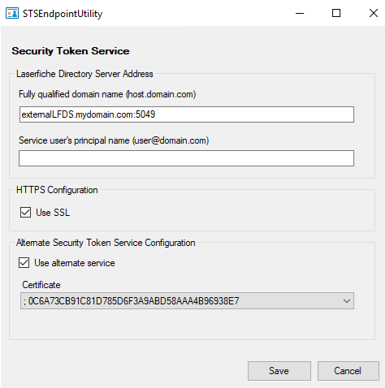
Configuring Additional WebSTS
LFDS machine name per DNS records in DMZ
  Include port 5049 if using HTTPS
UPN in DMZ: leave blank
Turn on alternate service
  Select certificate

Slide 20
External SSO Configuration FAQ
Several STS?
  Enabling in LFDS is a toggle: one or many
  Each install of a product can only point to one STS
Why is a certificate required?
  Can’t Windows Auth mode for message encryption
What about HTTPS communication for LFDS and STS?
  Still used in this scenario
Notes:
“Each product” = if Forms shares a routing server, it’s “one” installation, but see https://support.laserfiche.com/resources/3481/hosting-laserfiche-forms-10-in-a-perimeter-network-dmz for details on how to use two STS sites in this scenario.

Slide 21
Certificate Requirements
Must have private key
Do not need to be the same on each machine, but can
Must be able to perform chain validation
  Self-signed? Issue root certificate > individual certificate(s)
Notes:
(hidden slide)

Slide 22
External Access
Authentication Methods

Slide 23
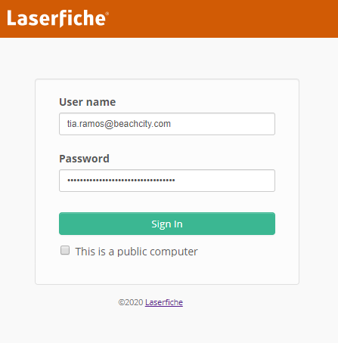
Alternatives to Windows Authentication
LDAP “simple bind”
  UPN: username@domain.com
  Windows password
  Least preferred
AD FS
SAML

Slide 24
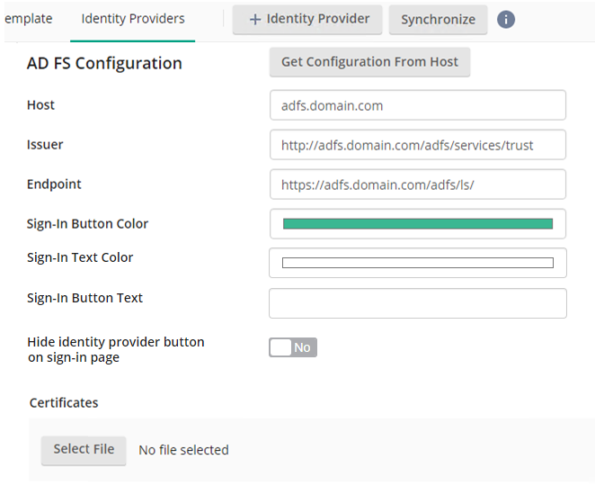
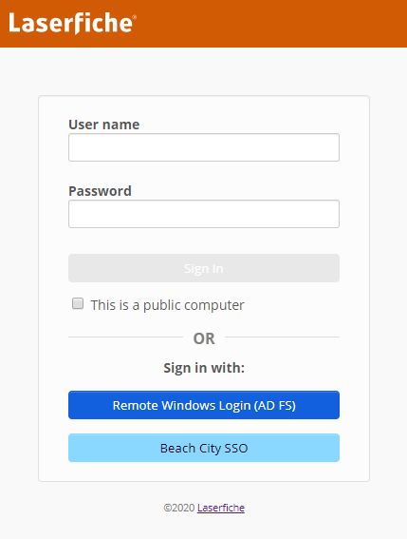

AD FS in LFDS
Secure login for Windows credentials outside network
Windows AD feature
Can pull config and certificate from host
  Helps prevent errors
  Update easily

Slide 25
SAML Authentication
SSO compatible with variety of web apps and directories
Users authenticate on 3rd party login page
Easily made accessible for external authentication
Tested SAML Providers
Okta
Onelogin
PingFederate
Azure
Shibboleth
salesforce
Notes:
Providers not on this page may still work, and if they don’t, we’d like to know!

Slide 26
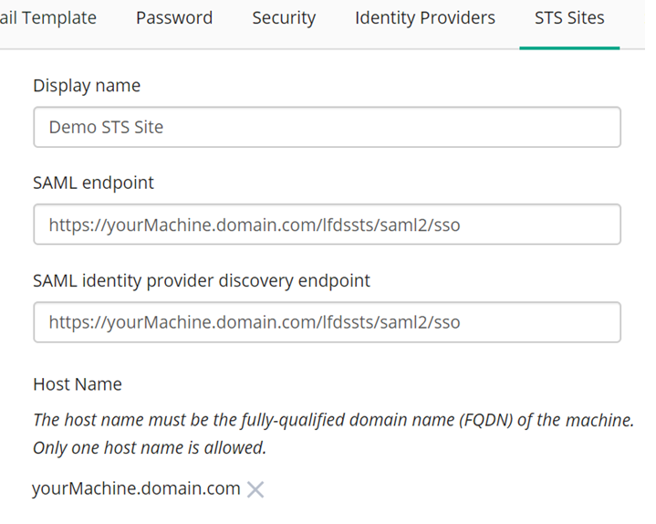
Register STS Site for AD FS or SAML
Default URLS
for the LFDS STS
Notes:
Required since STS can be installed separate from LFDS but AD FS and SAML need to know the locations of all valid STS sites

Slide 27
Authentication Options
Customize Login

Slide 28
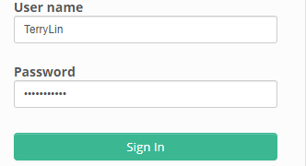
External Login Page
Windows Authentication hidden (default for separate STS)
Enable AD FS for employees outside the network
Show Username and Password for external Laserfiche users

Slide 29
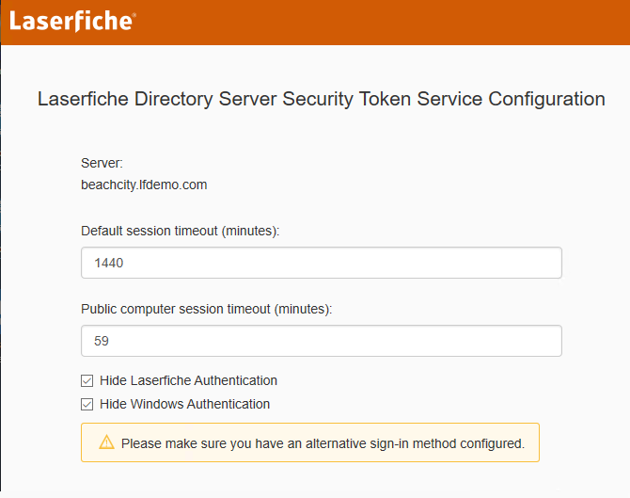
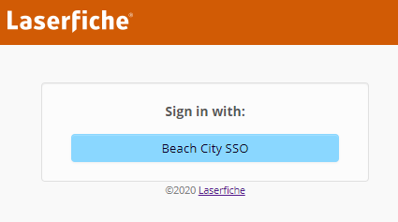
SAML Only
Hide:
  Laserfiche Authentication
  Windows Authentication
Customize button
Notes:
Separate from the LFDS web administration site. WebSTS config page shortcut is installed by default whenever LFDS STS is installed.
These two options are in the latest release (10.4.3)

Slide 30
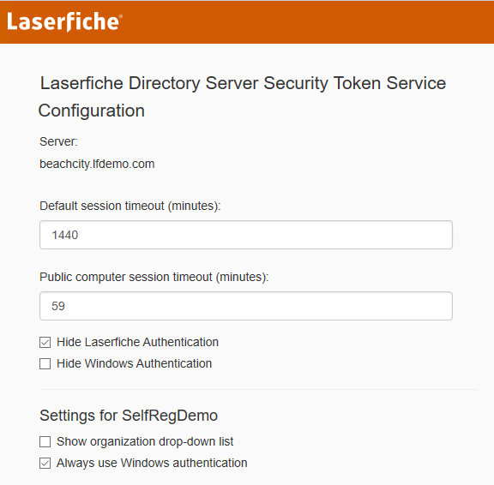
Internal Login Page
“Always use Windows Authentication”
Automatic Win Auth
  Users go directly to product
Notes:
This option as added in 10.4.1

Slide 31
SAML
Overview

Slide 32
How does SAML work?
3rd party provider responsible for authenticating user
User sent/returned to LFDS SSO page with “SAML Token”
SAML token contains all necessary information
  Username
  Name ID (or other unique identifier in SAML)
  Group membership
  Email, department, full name
LFDS cannot query SAML directories --- by design

Slide 33
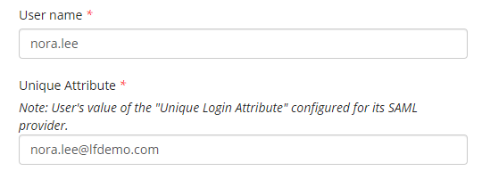
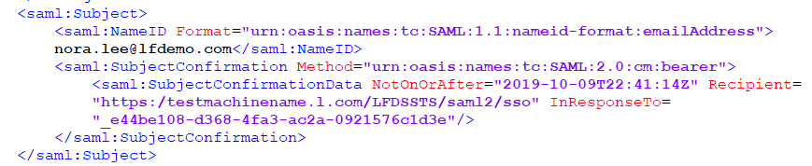
How does SAML work?
LFDS maps incoming users to existing user
  Format and attribute specified per IdP
  Unique attribute set per user
  Attributes are in SAML token
Notes:
Users without a match can’t log in (unless self-registration is enabled, but more on that later)

Slide 34
SAML
Configuration

Slide 35
Configuration Overview
Manual metadata exchange
Import from SAML provider to LFDS
Finish LFDS configuration after import
    STS Sites
    Certificates for encryption/decryption
    Optional settings (e.g., signed authentication request)
Export from LFDS
Import to SAML provider

Slide 36
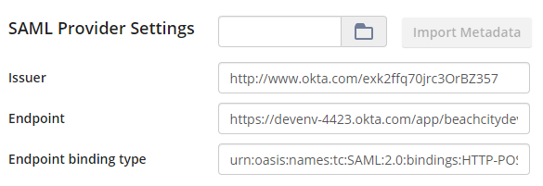
Configuration
SAML provider information
Issuer: SAML token provider
Endpoint: SAML provider url
Note: Import metadata to simplify
Notes:
Urls may be an external URL if the SAML provider is SaaS, like Okta is, making granting external users access is simpler.

Slide 37
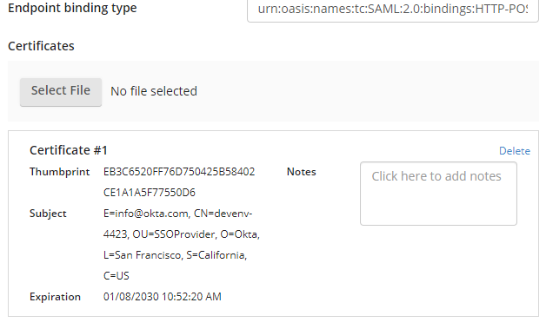
Configuration
SAML provider information
Certificate from SAML provider
Used to sign tokens to guard against:
Tampering with issued tokens
Pretending to be the SAML provider
Notes:
I want to point out the certificate here in particular, since there are a lot of cases where certificates pop up. This particular certificate is from the SAML provider, and it’s the one used to sign the SAML token

Slide 38
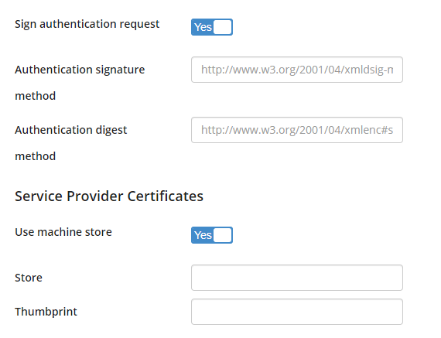
Configuration
Optional security
Sign authentication request
  Initial request from LFDS to SAML provider is signed
Specify certificate from LFDS machine
Note: exported metadata includes certs

Slide 39
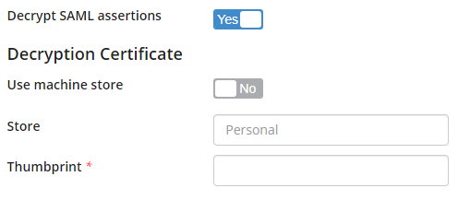
Configuration
Optional security
Encrypted tokens
  SAML tokens send to LFDS are encrypted
  Each Service Provider (such as LFDS) has unique decryption
  Certificate comes from LFDS
Note: exported metadata includes certificate

Slide 40
Certificates Summary
Signed by LFDS
Signed by SAML provider
Authentication request
Optional security
Ensures tokens only go to registered applications
SAML token signature
Digital signature
Tamper detection
Encrypted tokens
Uses certificate from LFDS
Protects against snooping

Slide 41
SAML
User Mapping

Slide 42
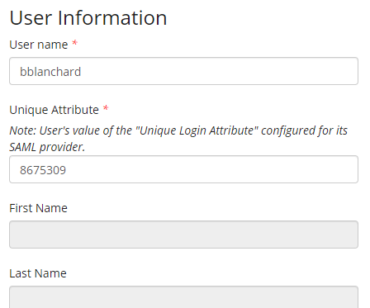
Configuration
Defining a SAML user
Unique attribute = how LFDS knows who this user is
Username is used in the rest of Laserfiche
Other info (e.g., first name) defined in SAML token
Notes:
Critical for making sure SAML authentication works

Slide 43

Configuration
User mapping settings
IdP Settings for user mapping (default)
  Name ID format
  Unique login attribute
Notes:
“Unspecified” setting will accept more specific formats, like emailAddress, but not the other way around --- so only specify the NameId format if you know it for sure.
SAML 1.1 unspecified accepts SAML 2.0 nameid-formats

Slide 44
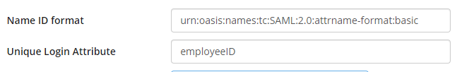

Configuration
User mapping settings
IdP Settings for user mapping (custom)
  Name ID format
  Unique login attribute

Slide 45
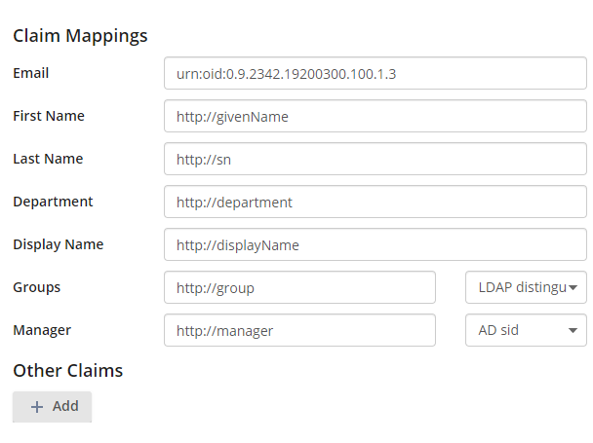
Configuration
Other user properties
LFDS updates on each login
Managed in external directory
Included in SAML token
Notes:
It’s important to configure groups correctly since we strongly recommend group-based security.

Slide 46
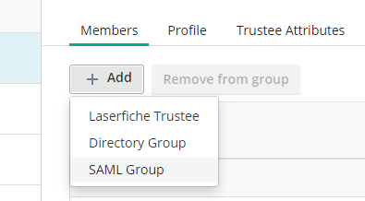
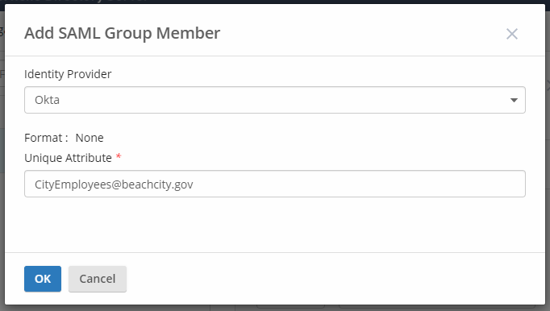
Configuration
SAML group support
Add SAML groups to LFDS groups
Notes:
But since we can’t query groups, how can SAML groups be used in group based security? Add them to LFDS groups --- type in the string.

Slide 47
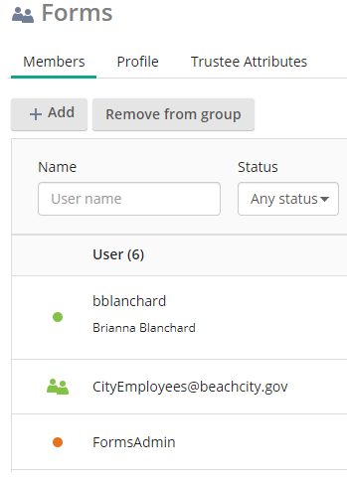
Configuration
SAML group support
Add SAML groups to LFDS groups
SAML groups inherit LFDS group
  Security in repository
  Forms access
Why?
  LFDS cannot query groups directly

Slide 48
SAML
User Management

Slide 49

Bulk Import
Simple option for smaller systems or initial setup
Max size ranging between 1k-6k users per import
Sample available in online documentation
Notes:
Can add users individually as well
https://www.laserfiche.com/support/webhelp/Laserfiche/10/en-US/administration/#../Subsystems/LFDS/Content/BatchImportOfUsers.htm#Batch2

Slide 50
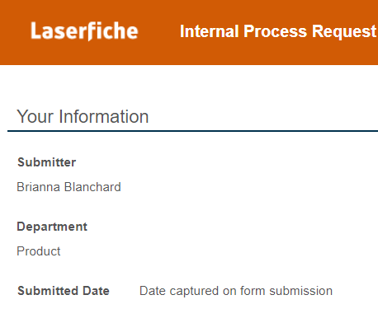
Self Service Registration
On-demand licensing for new AD or SAML users
  Allow new users immediate access to documents or forms
  Rely on group-based security
  Only need to register IdP in advance
Notes:
Enterprise identity management add-on (available for Rio/Subscription)

Slide 51
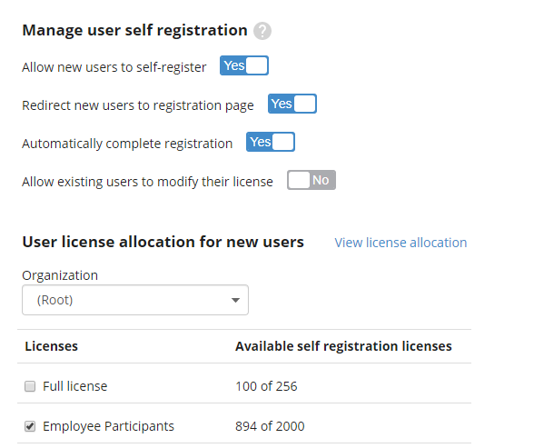
Self Service Registration
Required for automatic completion
Select license type
Notes:
The settings to provide the previous user experience.
Is a toggle of on/off for all identity providers (SAML and AD): cannot restrict based on group membership. To restrict it, turn off auto redirect and send out URL as needed (See next slide)

Slide 52
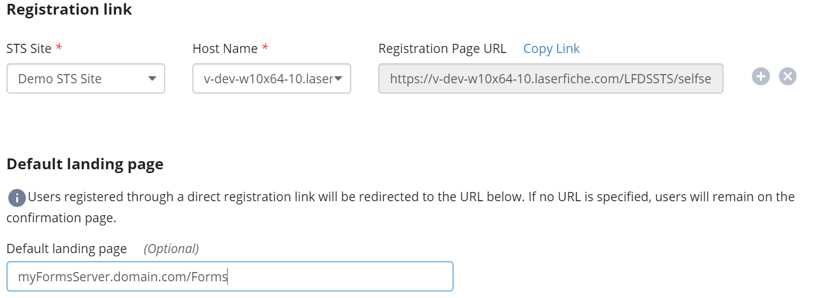
Self Service – Administration
License upgrade case (participant -> full)
Limiting self-registration
Have workflow email the link
Notes:
For cases where administrators want to limit access, turn off the automatic redirect and autocompletion.
Default landing page is where users will be sent if they access the self-service license url directly. For example, could enter Forms URL here.

Slide 53
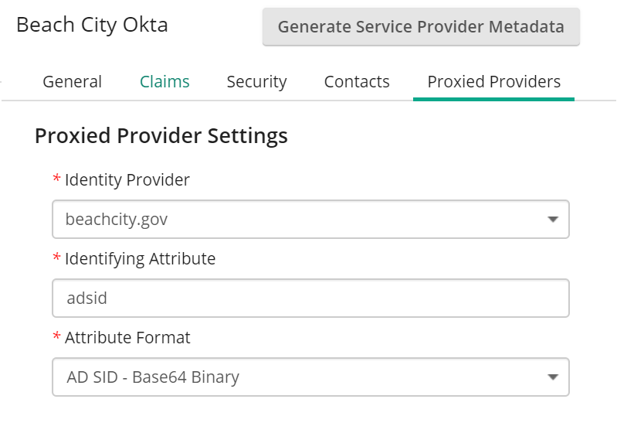
AD Sync + SAML
Transition from Windows Authentication to SAML authentication
Keep existing AD users + sync
Authenticate through SAML; appear as Window user

Slide 54
AD Sync + SAML
SAML token requirements
Must include AD groups and AD SID (AD identity providers) or LDAP distinguished name (LDAP IdP)
How LFDS maps to the Active Directory user
LFDS has no way of querying groups so mapping is essential
Notes:
So what does this look like?

Slide 55
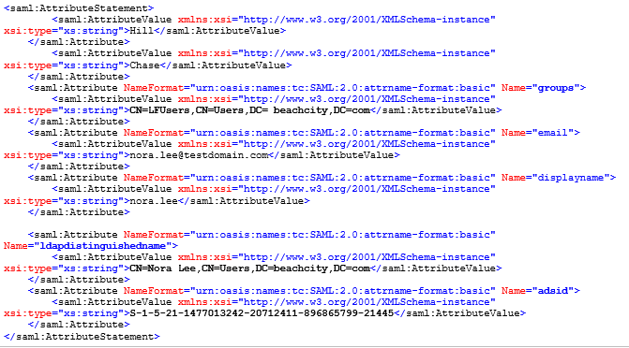
AD Sync + SAML
SAML token requirements
Group for mapping
(using LDAP DN)
User mapping

Slide 56
Compliance
Multi-factor Authentication

Slide 57
Multi-factor authentication
SAML -> use the SAML provider’s MFA options
Active Directory
  Set up MFA for AD FS and hide Win Auth
  Secure device login using MFA
  Add SAML on top of AD
  LDAP with MFA
Laserfiche users -> through LFDS, new in 10.4.3
Notes:
Keep within your identity provider. For internal needs, go to the central identity solutions you should already be using at your company

Slide 58
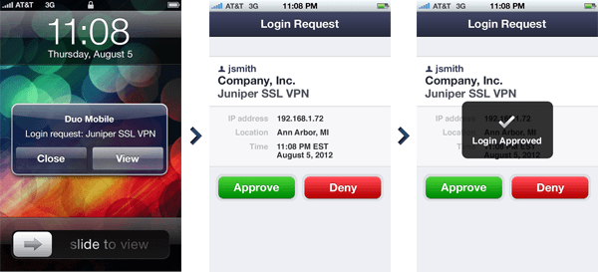
Example 3rd party MFA
Notes:
https://duo.com/docs/authapi-guide

Slide 59
Multi-factor authentication
Laserfiche user MFA through LFDS
Uses “TOTP” method for second factor
  Time-based One-Time Password
  Based off of “secret key” unique to each user
  Generates new 6-digit code every 30 seconds
  Compatible with any compliant application
    Google Auth, Authy, Okta Verify, Duo, etc.

Slide 60
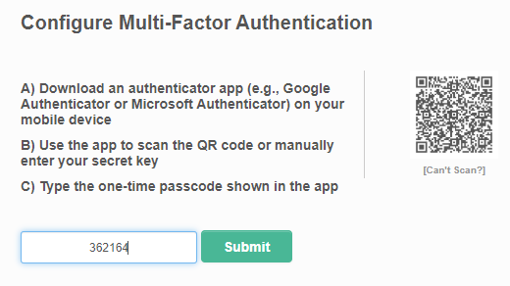

LFDS MFA – User Side
User Setup
Configured on next login
Compatible with all major TOTP providers
Required for future login
Notes:
Some MFA or SAML providers include a TOTP application --- shown here is the one for Okta.

Slide 61

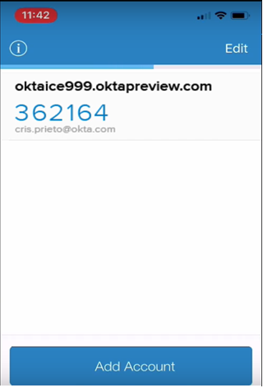
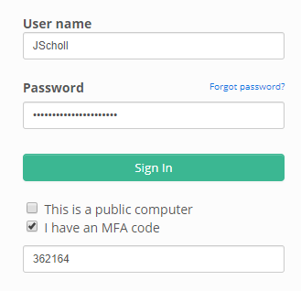
LFDS MFA – User Side
User Setup
Configured on next login
Compatible with all major TOTP providers
Required for future login

Slide 62
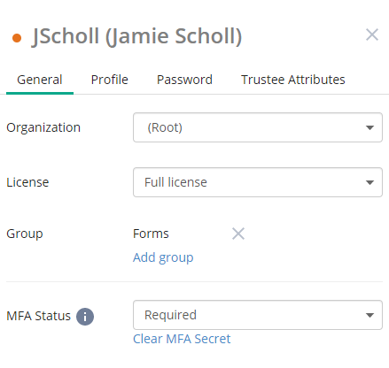

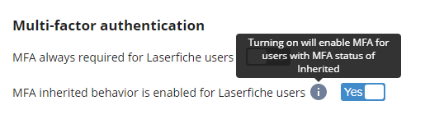
LFDS MFA – Admin Options
Set at database level as:
  Always required
  Default enabled with user-level customization
  Default off with user-level customization

Slide 63
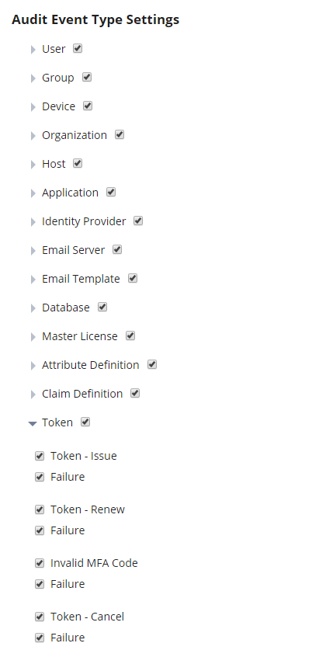
SSO auditing
Terminology and options
Token issue = login
Token cancel = logout
Log failed attempts
Log MFA code failure

Slide 64
Conclusion

Slide 65
Key Takeaways
Provide external users with secure access options
Tailor login page options to reducing training
SAML relies on correct mapping --- which you can do!
Implement MFA through relevant identity provider (now including LFDS for Laserfiche users)

