Slide 1
Enable Grid View
Objective: Return search results in grid view format
Purpose: Present results in a grid that resembles the folder browser, with sortable columns
How to: Laserfiche Answers - Enabling grid view for search results in WebLink
Notes:
[Advantages and disadvantages to either way of displaying results etc.)

Slide 2
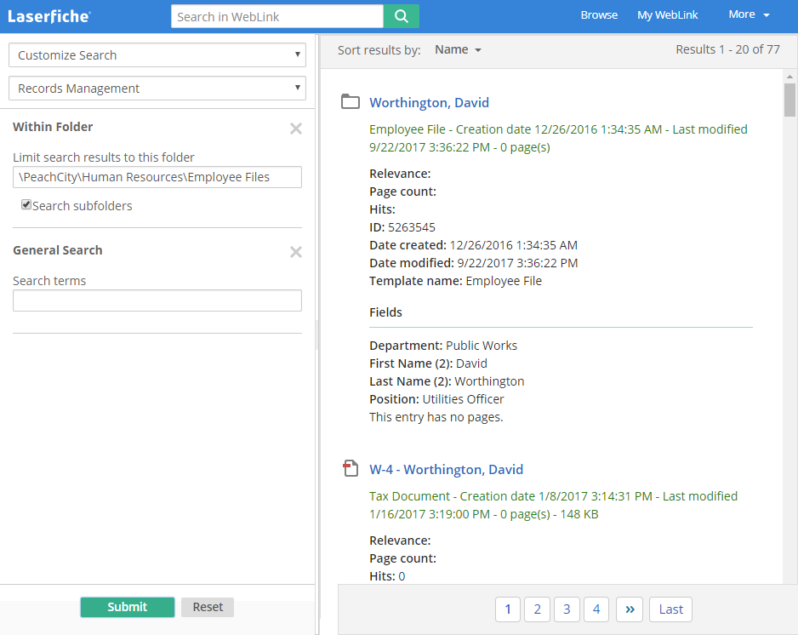
Enable Grid View: Before

Slide 3
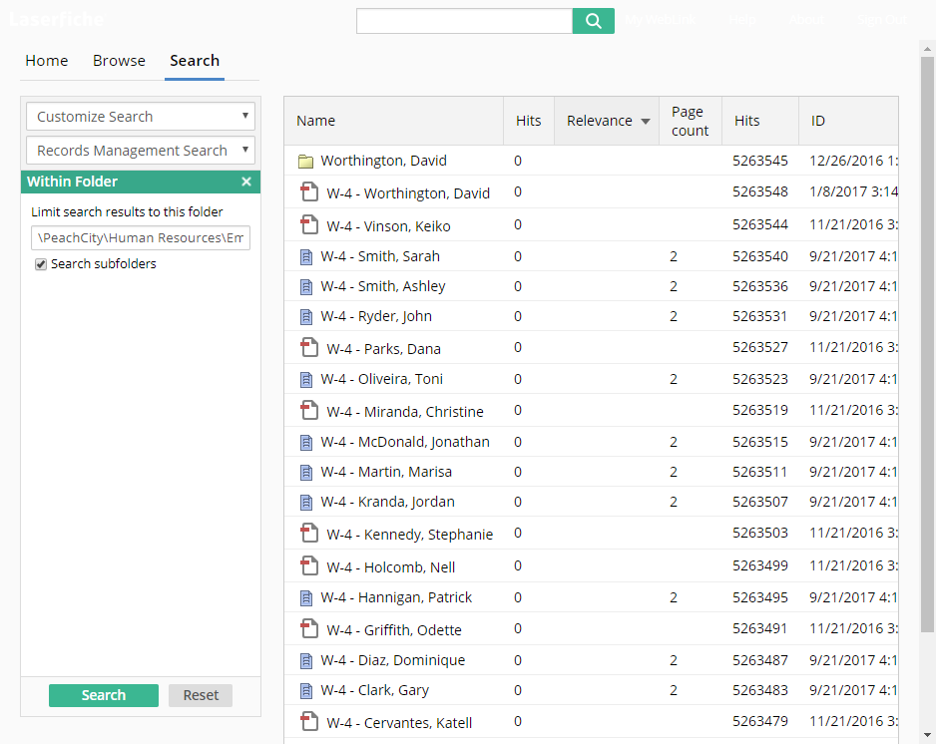
Enable Grid View: After

Slide 4
Enable Grid View
Default File location:
  C:\Program Files\Laserfiche\WebLink\WebLink\Web Files
Which Files:
  Search.aspx
  Welcome.aspx
Look for id="TheSearchResultsBrowserGrid"
Change Enabled=“true” from Enabled=“false”

Slide 5
Enable Grid View
<div style="display: table; table-layout: fixed; width: 100%;">
<%-- Set Enabled to true if using grid view; otherwise, set it to false for list view --%>
<weblink:SearchResultsBrowser
id="TheSearchResultsBrowserGrid"
runat="server" width="100%" MaxLength="20" Enabled="false" />
</div>

Slide 6
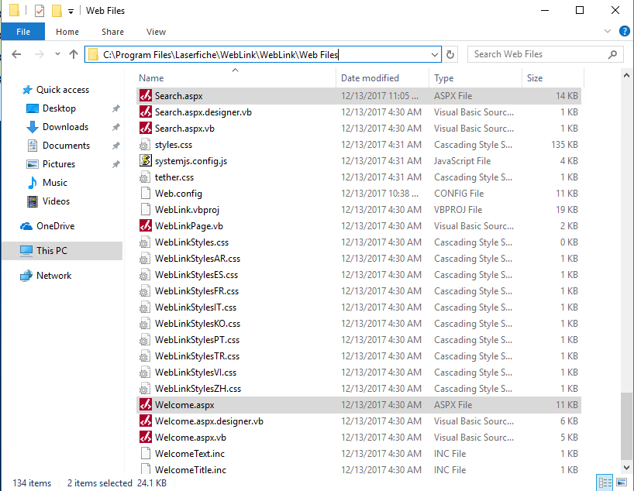
Enable Grid View

Slide 7
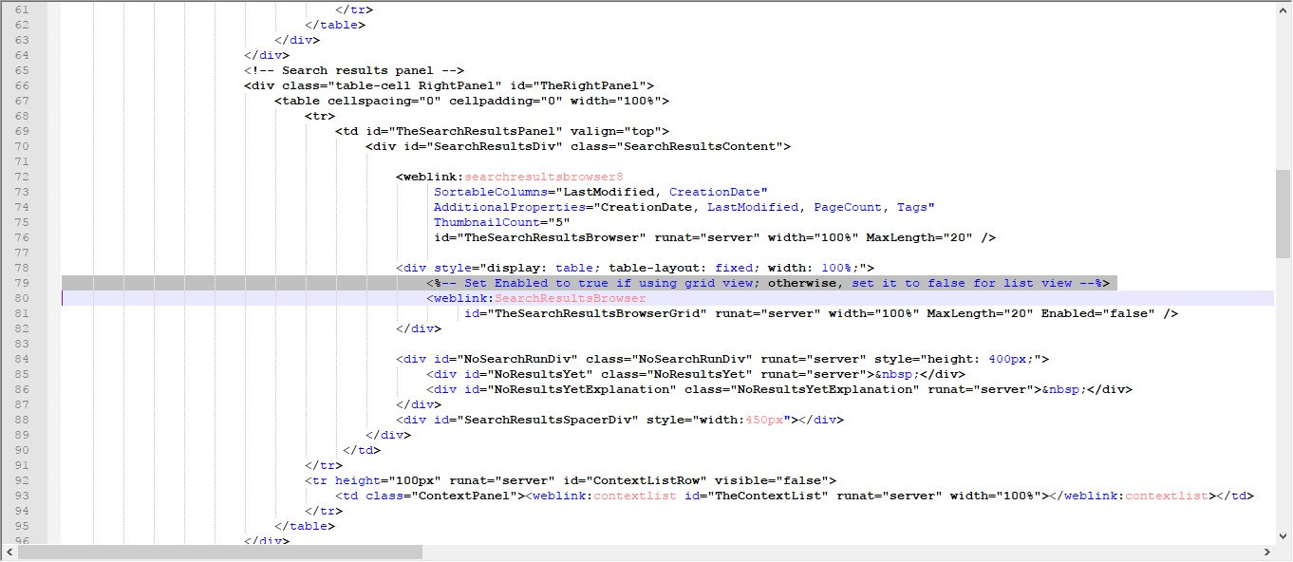

Enable Grid View

Slide 8
Enable Grid View

