Slide 1
WF 305: Automating Records Management with Workflow
Anita Chiang | Presales Engineer

Slide 2

Agenda
RM in Laserfiche
Automated Notifications
Transparent Records Management
Using the SDK

Slide 3

Audience
Records Managers
Administrators
Process Designers
Developers

Slide 4
Records Management in Laserfiche
DoD 5015.2 Certified
Lifecycle defined with cutoff definitions and retention schedules
Tracks timelines, but does not carry out records management actions

Slide 5

Record Lifecycle
Active: Still in use
Active
Retention
Disposition

Slide 6
Record Lifecycle
Cutoff: Transition point to read-only state
Active
Retention
Disposition

Slide 7
Record Lifecycle
Retention: Length of time a record must be kept
Active
Retention
Disposition

Slide 8
Record Lifecycle
Disposition: Destruction or accession to an archive
Active
Retention
Disposition

Slide 9
Records Management in Laserfiche
Why use Workflow?
Workflow is built into Laserfiche
Automated sorting into record series
Additional notification options
Extend records management functionality with SDK

Slide 10
Automating Notifications

Slide 11
Notifications
How do you know a record requires action?
Built-in quick access view in the web client
Searching by records management status in the advanced search options
What if you want an email instead?

Slide 12
Notifications
Notify records managers using email on a specified interval
Access records properties
Generate well formatted email reports
Make use of escalation and deadline activities

Slide 13
Demo
Notifications

Slide 14
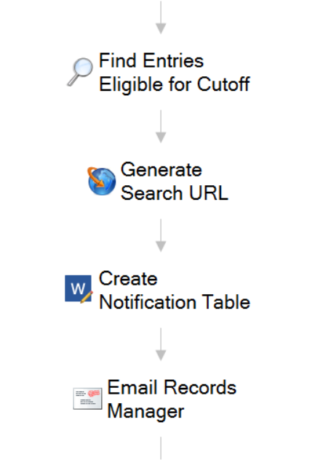
Workflow in Action
Starting rule type: Schedule
Allows workflow to be run on a configurable interval so notifications are sent regularly

Slide 15
Search Repository
Use search syntax to find all folders ready for disposition

Slide 16
Generate URL
Make a handy-dandy URL so users can see entries in Laserfiche as well

Slide 17
Update Word Document
Table Field Merge allows for additional formatting
“Emit email token” under advanced properties

Slide 18
Email
Use email token created by Word document activity
Send records manager a formatted table with hyperlinks!

Slide 19
Transparent Records Management

Slide 20
Using Records Management
How do you make sure records are filed properly?
Records inherit properties from their record series
Lifecycles are calculated from the filing date of the record folder
With multiple users importing content, who makes sure records are placed in the right folder?

Slide 21
Transparent Records Management
Use shortcuts to give business users access to the original record
  Retention is set on the source document
Organize shortcuts within departmental folder structures as needed
  Documents must reside in record series

Slide 22
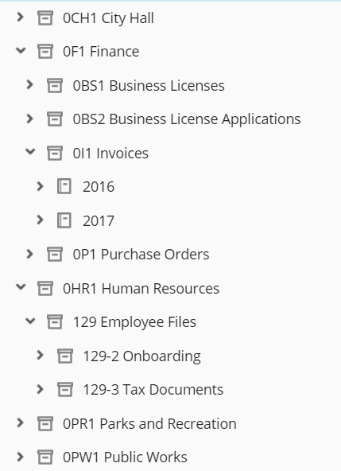
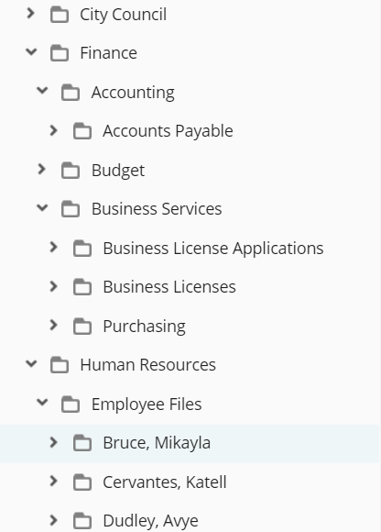
Transparent Records Management

Slide 23
Demo
Transparent Records Management

Slide 24
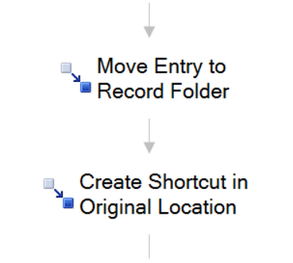
Workflow in Action
Starting rule type: Condition
Start different TRM workflows when entries are created with different templates, paths, etc.
Can be a part of another workflow process!

Slide 25
Move Entry (1)
Move entry to the correct record series
Can dynamically create record folders for each year instead of hardcoding by using token editor

Slide 26
Move Entry (2)
Use this to create a shortcut in the original file location
Global tokens—Entry Path for the starting entry

Slide 27
Using the SDK

Slide 28
Considerations
Make sure you know your organization’s needs.
Don’t automate anything that can’t be undone.
Using the SDK isn’t scary!
Notes:
The DoD 5015.2 certification assumes that records actions are being overseen by a records managers. So if you’re automating something that DoD 5015.2 requires someone to be watching and carrying out specific actions, that’s where we get into trouble.
If we just need to follow timelines, and there’s not necessarily someone who’s going to be going around and carrying out the actions manually, then we can simplify this and carry on with SDK automation.
Other option could be to automate things like filing date. You can still have notifications for this so there’s accountability. Automate things that are reversible, so don’t automate things like destruction

Slide 29
Using the SDK
Can write SDK scripts using the Workflow “SDK Script” activity
Don’t worry about upgrades breaking your custom script
RepositoryAccess library provides many of the tools for quick customizations
Notes:
SDK script activity will handle connecting to Laserfiche and cleans up the connection, and working with the entry
Default libraries will be installed and will stick around through upgrades, custom references might not
RepositoryAccess is the .NET library for interacting with the Laserfiche server, so it is the go-to tool for automating a lot of these actions

Slide 30
Scenario 1: Set Filing Date
Filing date is used in some cases to calculate cutoff (and therefore disposition)
When creating new record folders, the filing date is automatically set to today’s date
If backfiling, the filing date needs to be changed to accurately reflect the real filing date outside Laserfiche

Slide 31
Scenario 1: Set Filing Date
Solution: grab Windows file creation date upon import, then use the SDK to write it to the Filing Date records property
Note: Creation date is not available as a token in the web client.

Slide 32
Demo
Set Filing Date with SDK

Slide 33
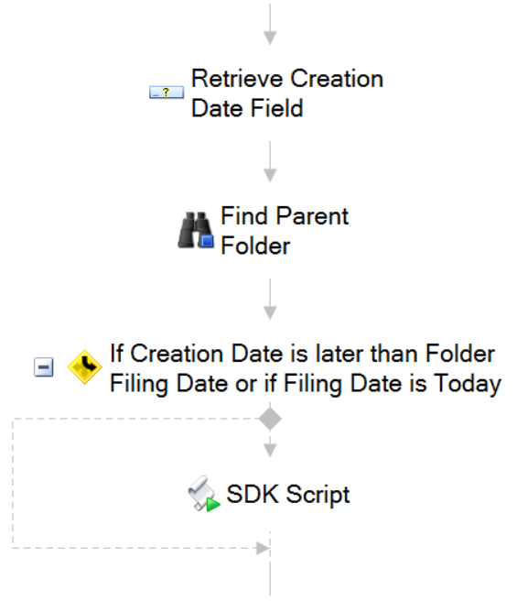
Workflow in Action
Starting rule type: Condition or Schedule
Run this workflow upon file import

Slide 34
Retrieve Field Values
Retrieve the file creation date, which should be set upon import within the Date field
We got ours from Import Agent

Slide 35
Find Entry
Use the “Find Entry” activity to make the parent folder available for future steps
Filing date should be set at the folder level

Slide 36
Conditional Decision
Only change the date if it’s too early or if it’s been created today
Notes:
Latest filing date!

Slide 37
SDK Script
This is where the automation occurs!
SDK Script opens up a script editor
Visual Basic .NET or C#.NET
Notes:
Latest filing date!

Slide 38
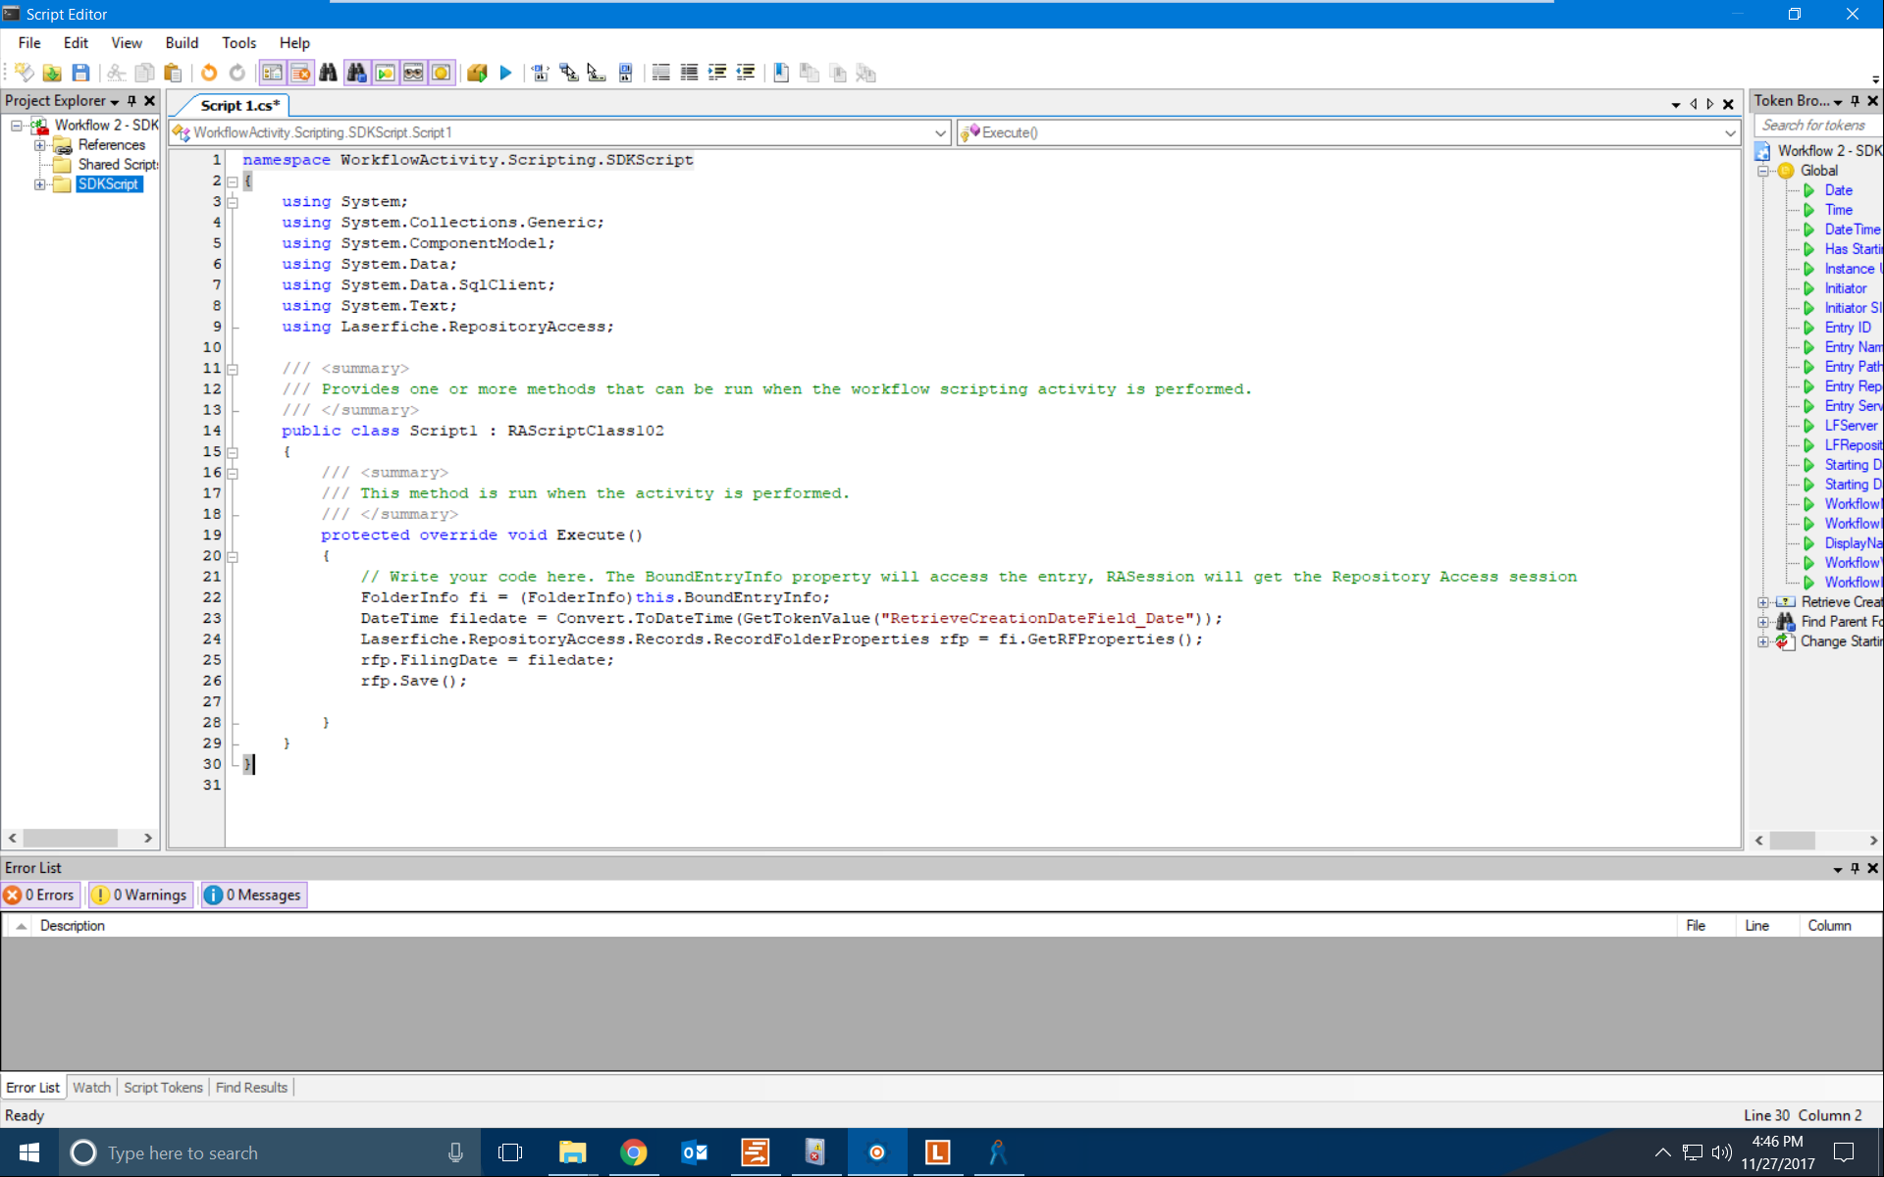
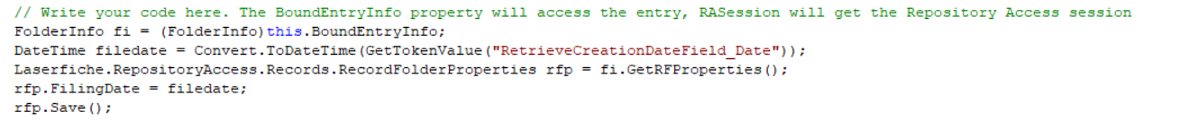

Slide 39
SDK Script
FolderInfo fi = (FolderInfo)this.BoundEntryInfo;
DateTime filedate = Convert.ToDateTime(GetTokenValue("RetrieveCreationDateField_Date"));
Laserfiche.RepositoryAccess.Records.RecordFolderProperties rfp = fi.GetRFProperties();
rfp.FilingDate = filedate;
rfp.Save();

Slide 40
Scenario 2: Automated Cutoff
Records eligible for cutoff must still be manually cut off by a records manager
Information about who performs the cutoff is stored in Audit Trail, which is not accessible to everyone

Slide 41
Scenario 2: Automated Cutoff
Solution: Use Workflow to find all records eligible for cutoff, then use an SDK script to cut them off when a records manager approves
Added benefit: Business process resolutions can be used to display person responsible for cutoff

Slide 42
Demo
Cutoff with SDK

Slide 43
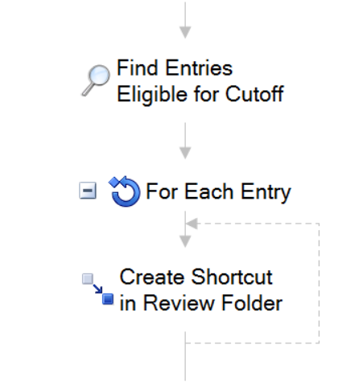
Workflow in Action
Find relevant entries and create shortcuts

Slide 44
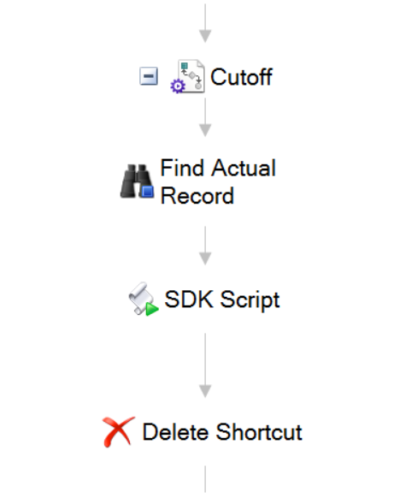
Second Business Process
Use business process instructions to record the record manager’s name and approval time in the resolution
Allows users to click button in the client toolbar

Slide 45
Second Business Process
Because our first workflow provides shortcuts, we need to make sure we’re acting on the original record

Slide 46
SDK Script
Automation point
Get record folder properties and carry out the actions necessary, in this case, cutoff

Slide 47
SDK Script
FolderInfo fi = (FolderInfo)this.BoundEntryInfo;
Laserfiche.RepositoryAccess.Records.RecordFolderProperties rfp = fi.GetRFProperties();
if (rfp.IsEligibleForCutoff)
{
fi.Cutoff();
fi.Save();
}
Notes:
Repository Access is relatively easy because it follows the same sort of logic that you as an end user might do when you’re looking at an entry in the repo anyway (get an object, look at its properties, you change one, and you save it!)

Slide 48
Conclusion
Supplement existing records management functionality with Workflow
Make sure everyone is notified when necessary
Scripting isn’t (that) scary!

Slide 49
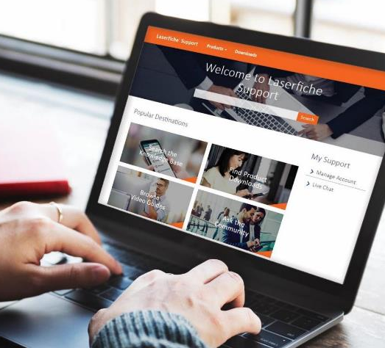
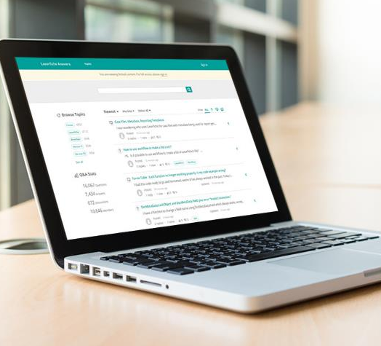
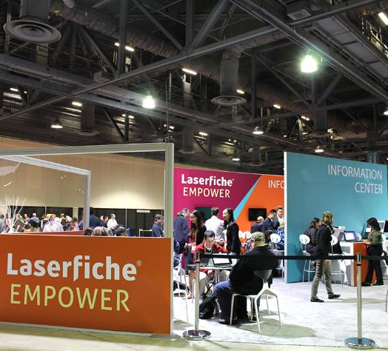
Next Steps
Laserfiche Support
Laserfiche answers
Info center
support.laserfiche.com
answers.laserfiche.com
Located in the Exhibit Hall

Slide 50

Online Course Survey
Rate your classes and share your ideas:
Use the course selector on the Empower website or in the Empower App

Slide 51
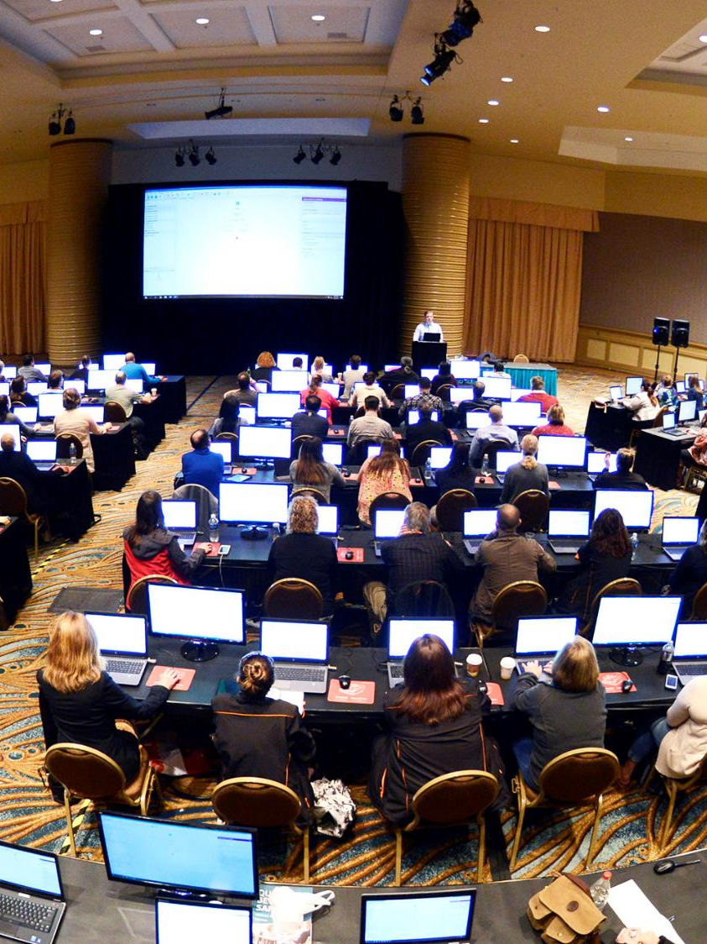
Recommended Classes
Workflow 301: Advanced Process Design
Developer 201: Overview of SDK Programming

Slide 52
Questions?

Slide 53
WF 305: Automating Records Management with Workflow
Anita Chiang | Presales Engineer

