Slide 1
Laserfiche Business Process Library: Jumpstart Business Process Automation
Brandon Buccowich, Technical Marketing Engineer | Katie Fries, Presales Consultant II

Slide 2
Agenda
Business Processes in Your Organization
Business Process Library Overview
Demo
Summary and Resources

Slide 3
Your Organization’s Business Processes
New Hire Onboarding
Travel and Expense Request
Network Access Request
What business processes do you
have in your organization?
Public Records Request
Diploma Request
New Account Opening

Slide 4
Your Organization’s Business Process Automation Challenges
Not enough resources to build out processes from scratch?
Not sure where to start in automating a process?
Initial development effort takes too much time?

Slide 5
Business Process Library Accelerates Automation Efforts
Process Automation Timeline
Even without resources being immediately available, you can have at least have a place to start to help save time with the initial development effort.

Slide 6
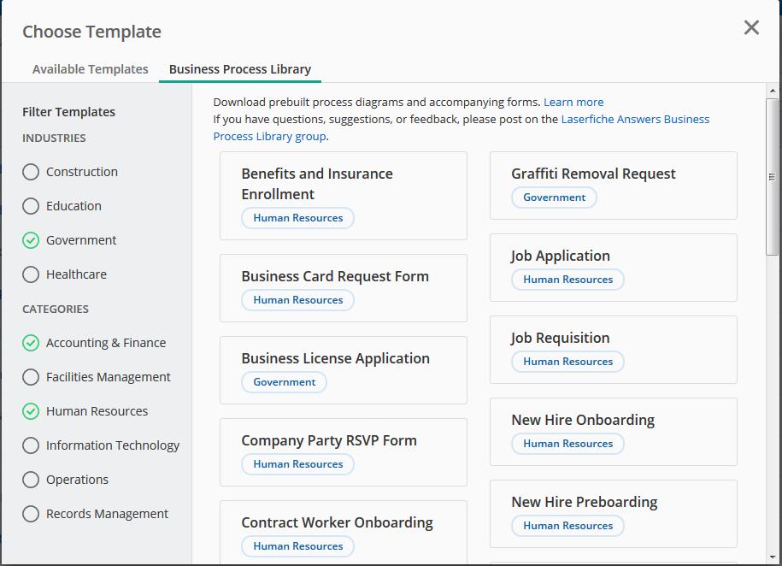
Business Process Library Overview
Collection of prebuilt, industry- and horizontal-specific processes
Easy to configure and extend
Integrated into Laserfiche Forms 10.1
Many processes validated by Laserfiche user community

Slide 7
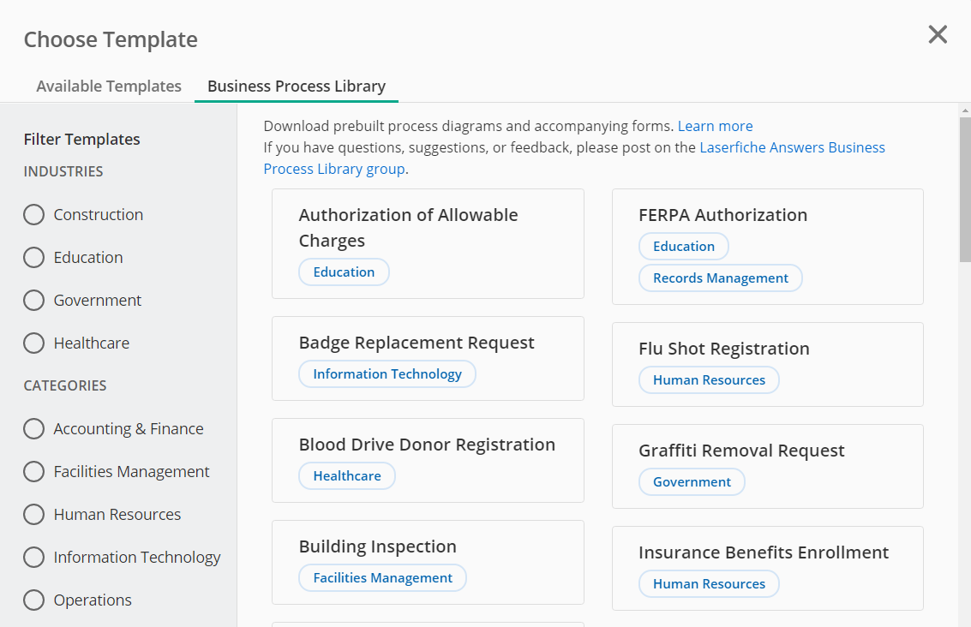
What’s Included in a business process template?

Slide 8
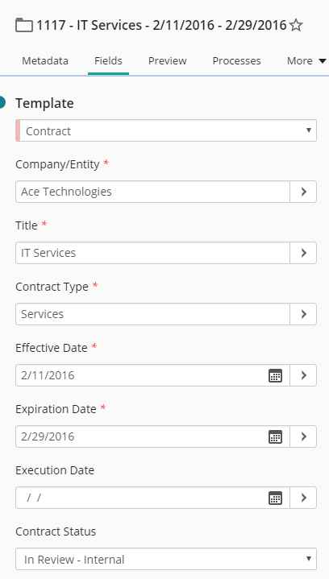
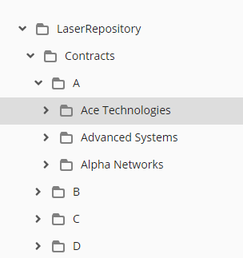
What is Included? – Laserfiche Repository Briefcase
Basic folder structure
Sample documents
Complete metadata model – templates, fields, tags, etc.

Slide 9
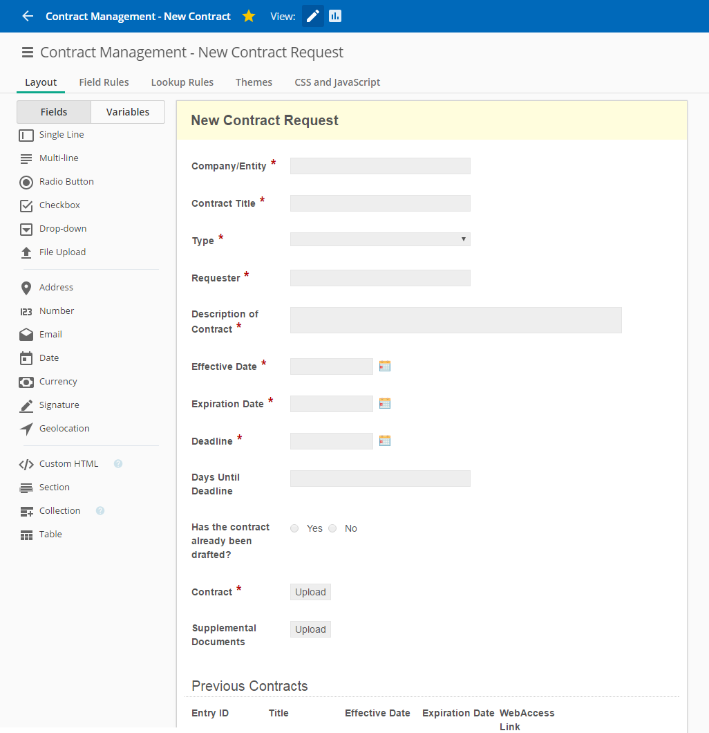
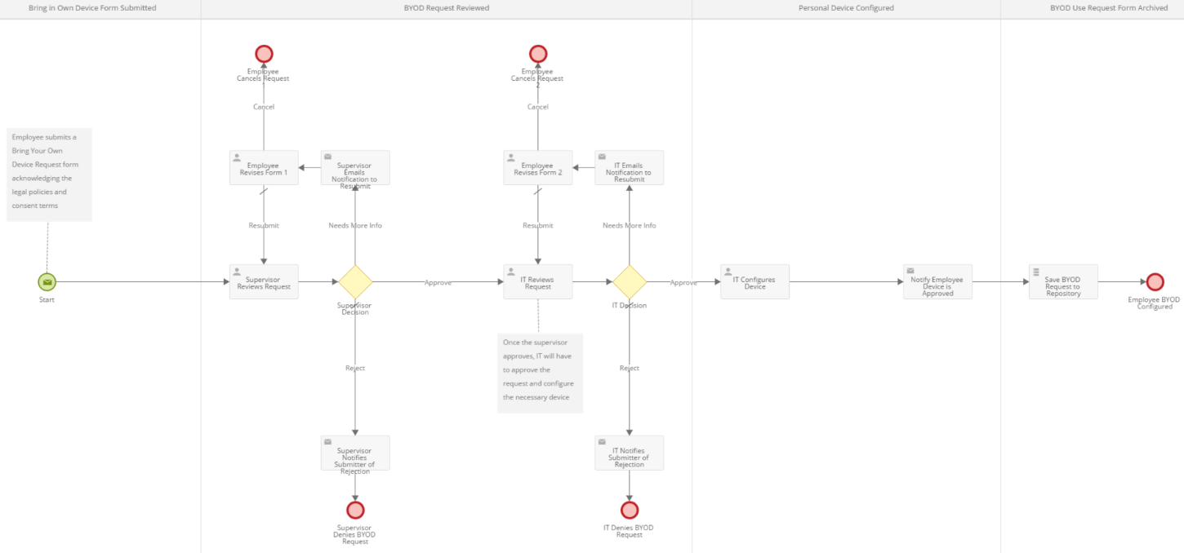
What is Included? – Electronic Forms and Process Diagram
General electronic form that can be modified for specific use case
High level business process that can be modified or extended as necessary

Slide 10
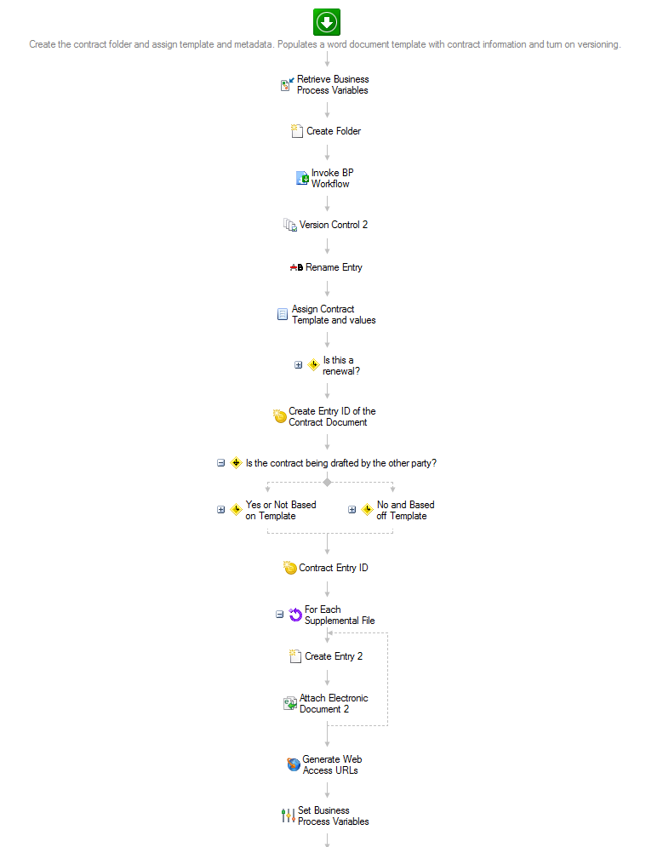
What is Included? – Workflow Files
Lower level business rules that define how the system reacts to user activity
Can be customized or extended as necessary

Slide 11
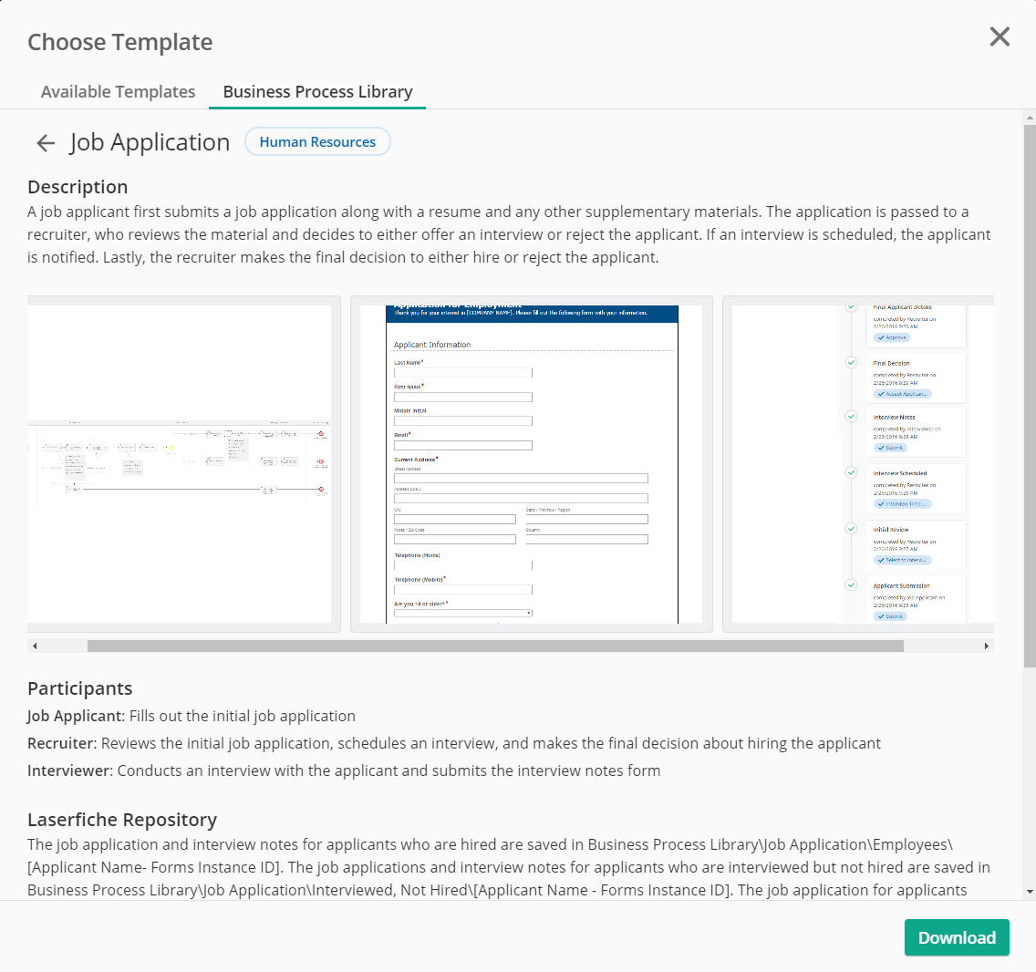
What is Included? – Documentation
Simple processes – detailed annotation within the forms, forms process and workflow rules
Complex processes – detailed documentation explaining the process and ways in which it can be modified or extended

Slide 12
Four Simple Steps to Download Templates from the BPL

Slide 13
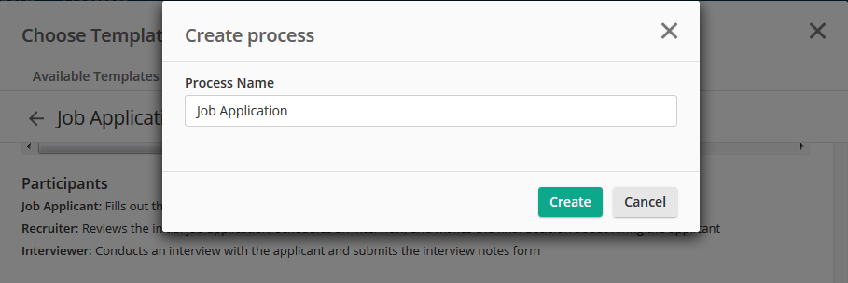
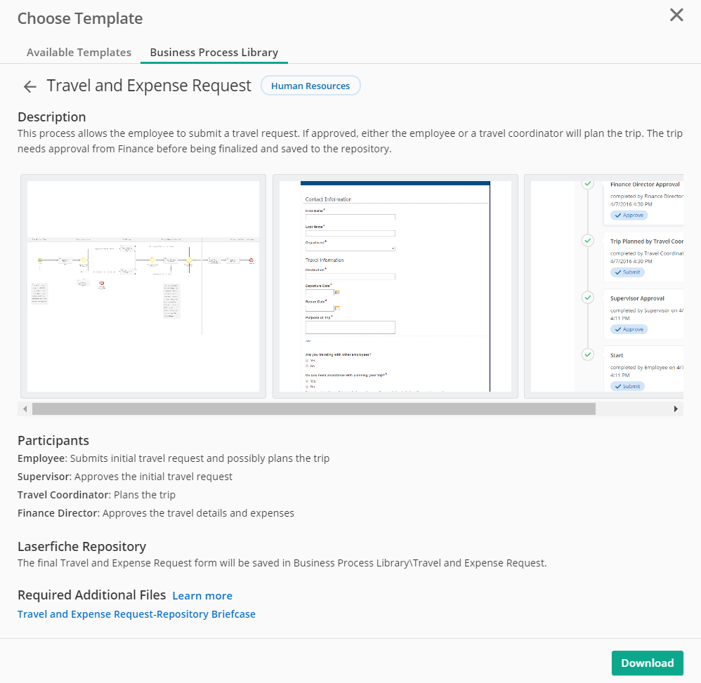
Four Simple Steps to Download Templates from the BPL
1. Download
Notes:
Downloading a process will bring the process directly into the user’s LF Forms environment automatically

Slide 14
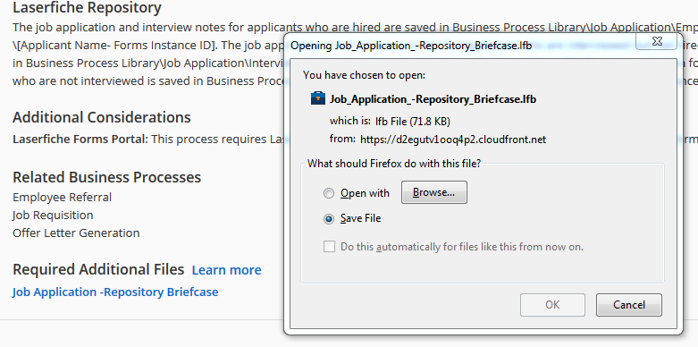
Four Simple Steps to Download Templates from the BPL
2. Import
Notes:
Import the repository briefcase file which has the folder structure, sample documents, and metadata field template

Slide 15
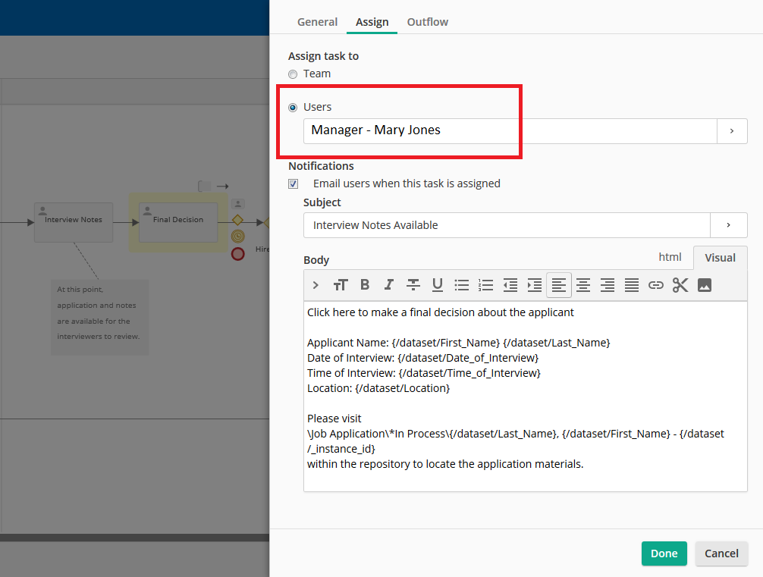
Four Simple Steps to Download Templates from the BPL
3. Configure
Notes:
Processes are set to default values that will need to be configured by the end user such as email/task routing, form text, additional approval tasks, etc.

Slide 16
Four Simple Steps to Download Templates from the BPL
4. Deploy
Notes:
Once the process is configured and tested, the process can be deployed in your organization.

Slide 17
Business Process Library Demo

Slide 18
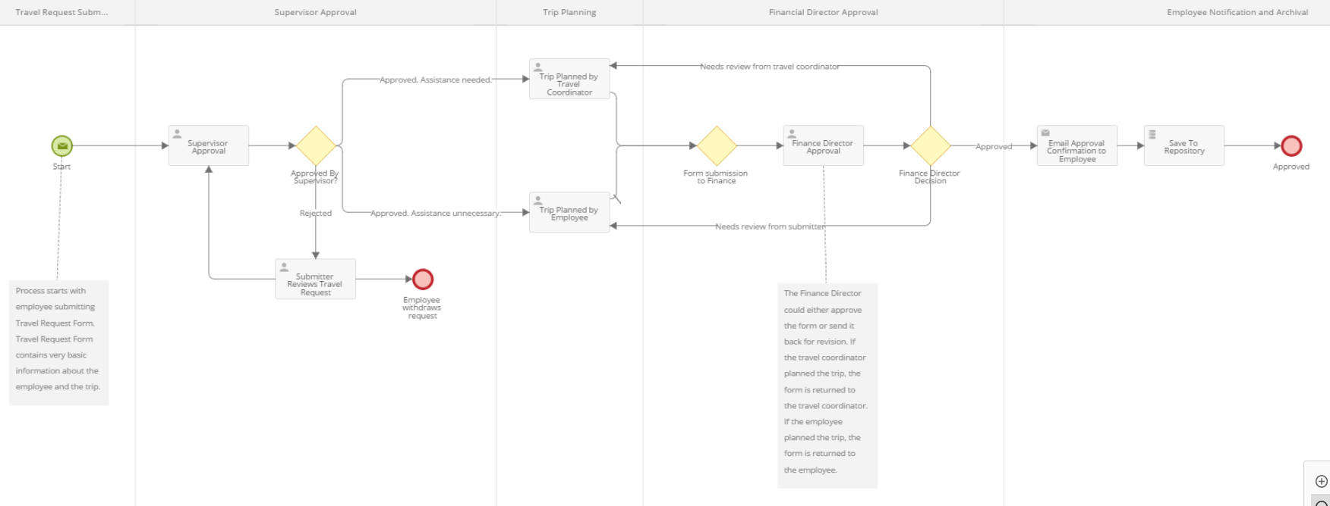
BPL Demo: Travel and Expense Request

Slide 19
Summary
With the BPL, you can:
Select from a variety of prebuilt process solutions
Configure process templates as necessary
Expedite process implementation

Slide 20
Business Process Library Resources
For more details on how to access the BPL and requirements, please see the Laserfiche Forms Help File Guide
Submit feedback and post questions through Laserfiche Answers Business Process Library Group
Submit built out business processes and business process ideas to the BPL team by submitting the Business Process Submission/Suggestion Form – receive a free CPP code per organization that submits the form!

Slide 21
Thank You! Questions? Feedback?

